Slide 1
Adidasium
Democratizing Sport Data

Slide 2
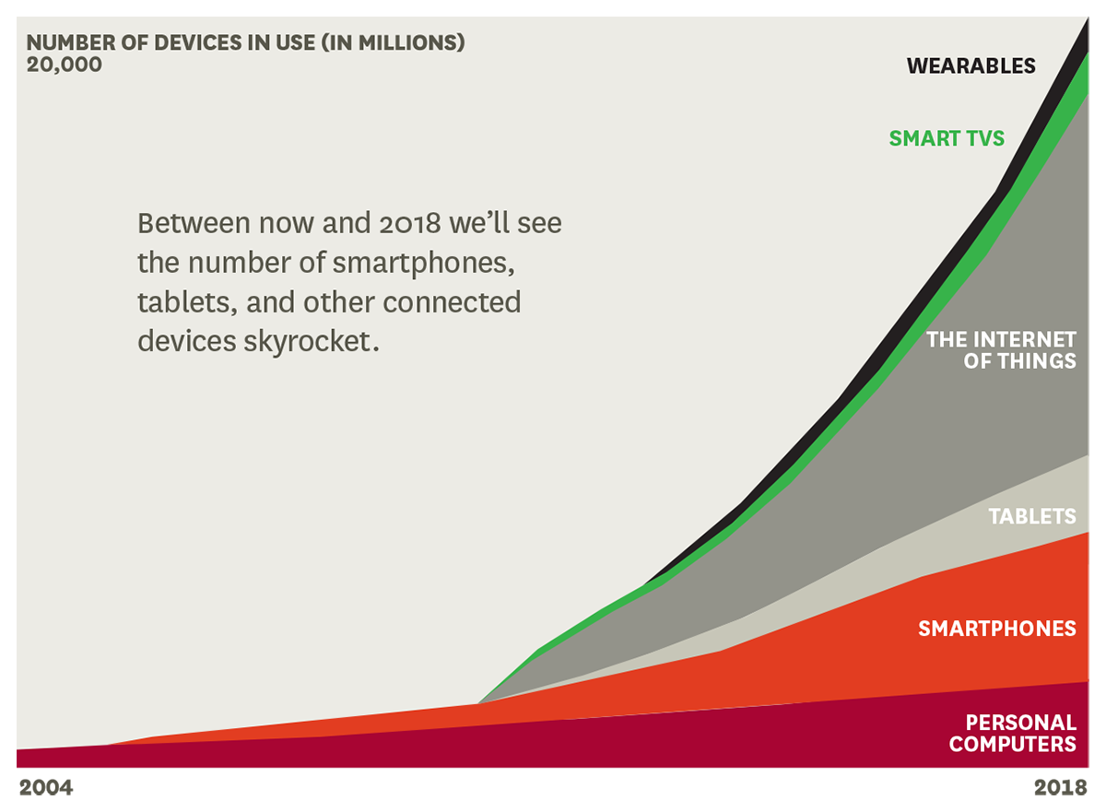
Why ?

Slide 3

Why doesn’t data work (now)
Human Failure
Insecure Users
Zero Customization

Slide 4
Lifecycle
Uploads Data
Generates Value
Data Scientist
Customized Solutions
Improvements
User
Market Place
3rd Party Companies

Slide 5
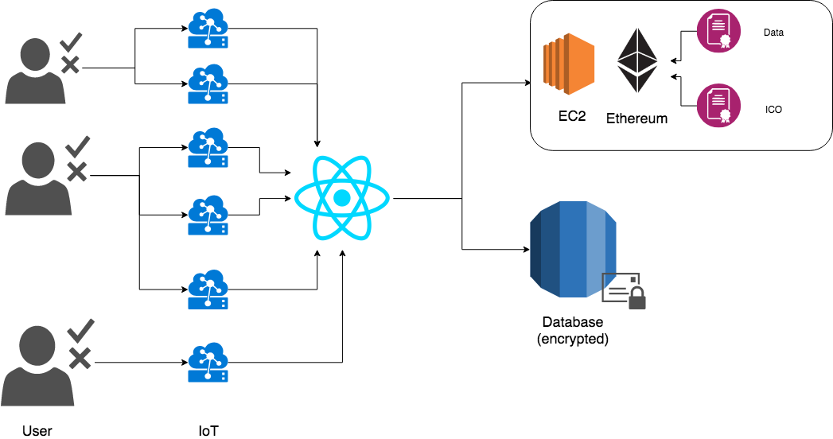
IT – Data Upload

Slide 6
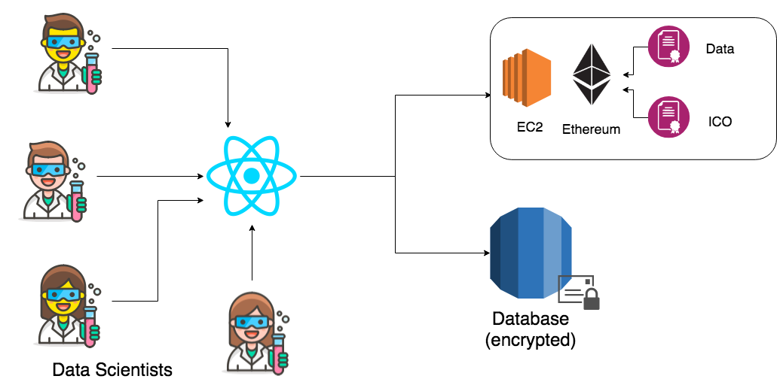
IT – Data Download

Slide 7
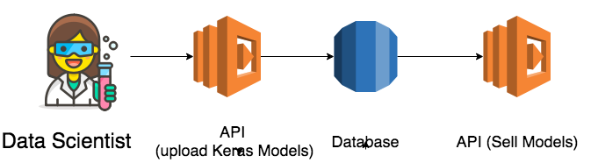
IT – Market Place

Slide 8
Use case
1
2
3
4
People prepare for Marathon (data)
Data Scientist predicts the needed Training (value)
Runntastic includes
»Training needed module
Runner improves in Marathon

Slide 9
Value Proposal (Humanity)
Optimize customization
Get user data
Free the data
Set incentives for users to share their data
Give Data Scientists their needed tools
Beautiful customized machine learning models

Slide 10


Slide 11
Democratizing data, customizing sports, impacting atlethes

Slide 12
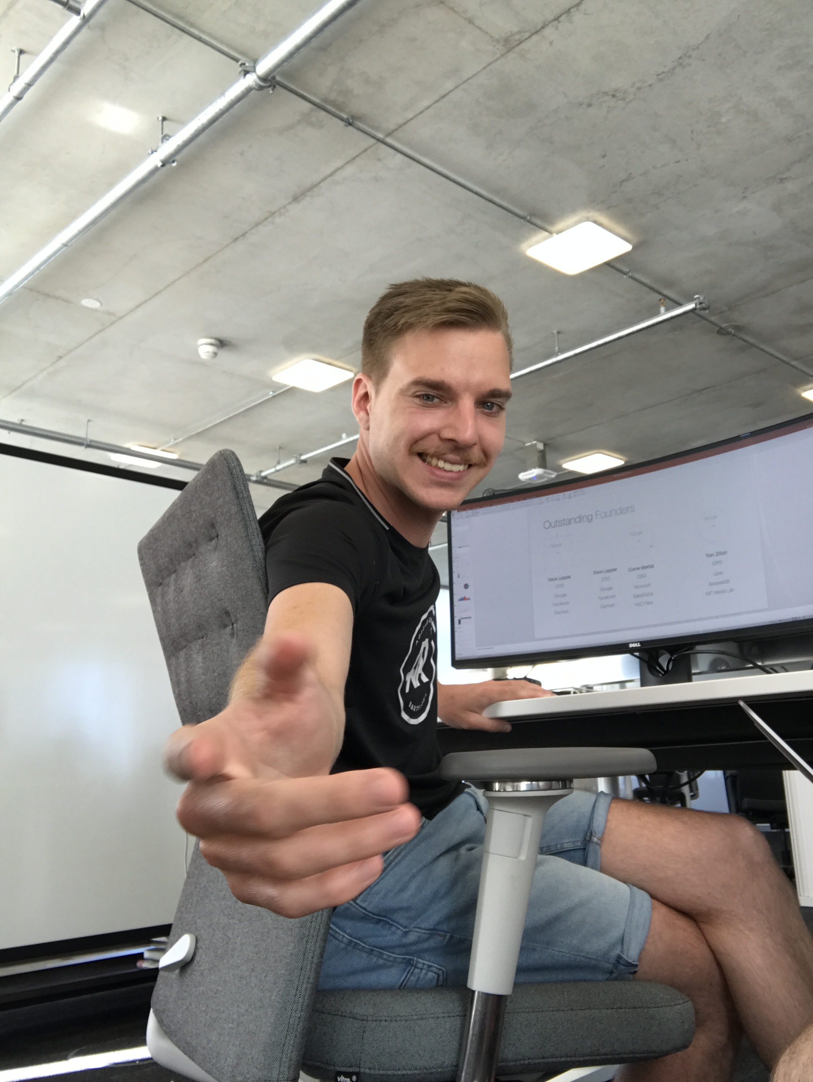

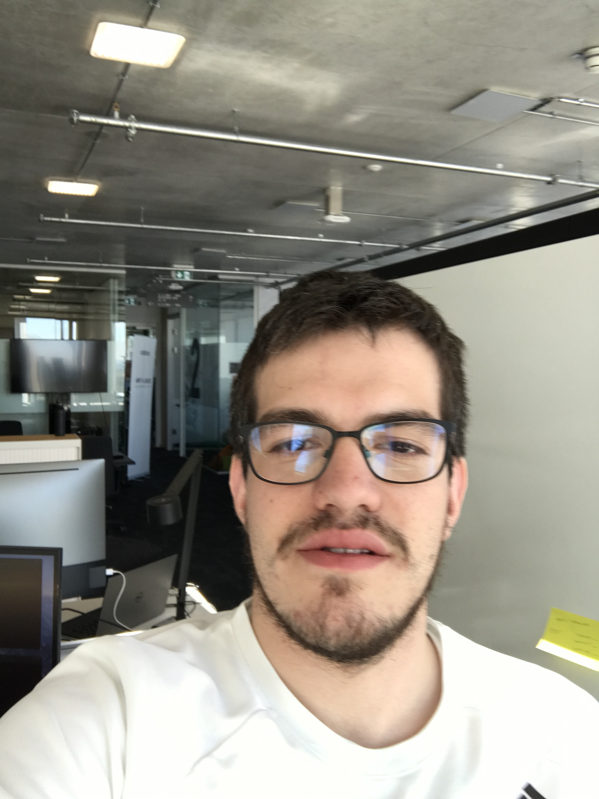

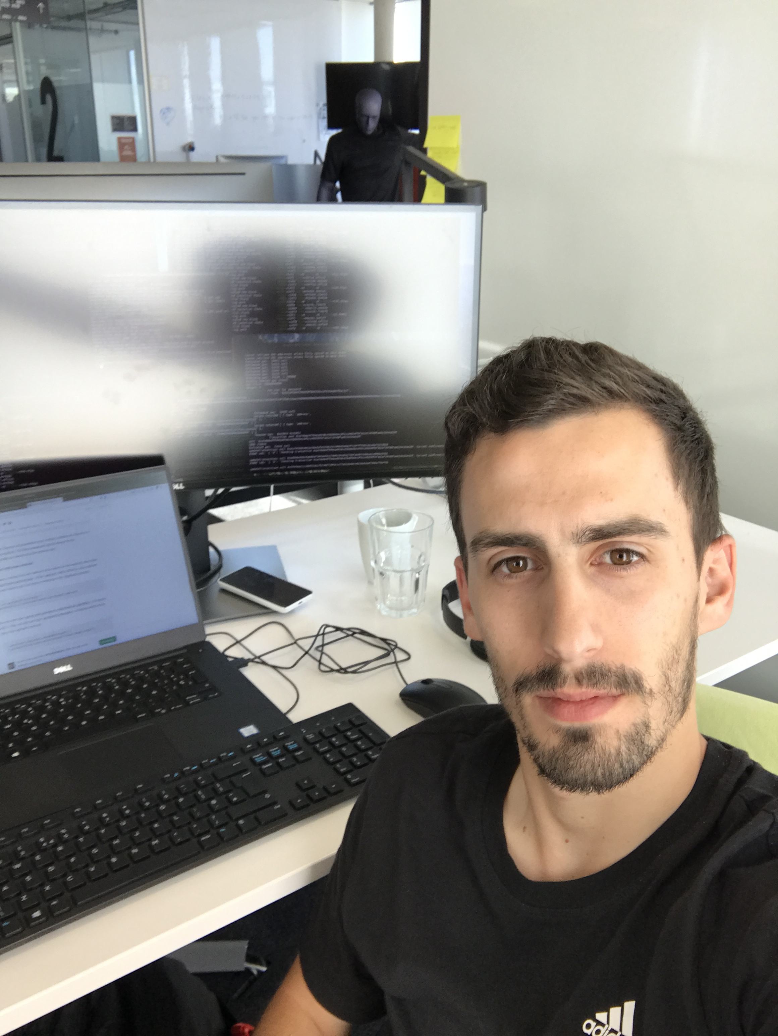
Outstanding Founders
Dirk
PhD
Dimitri
Kiwi
Lukas Kiwi
Joan Kiwi
Victor
Nixi1

Slide 13
Adidasium ICO

Slide 14
Why Adidas?
Acessing Trends
Be in Charge
Make money
Be the first notified about new ways to use data
Gather data from competitors, Brand Adidasium
Become a cloud

Slide 15
Transform sport data to value
Let the user participate in the value creation of his data. Making data transfer private.
#IoT #Blockchain #AI

Slide 16

Data Insecurity
=
No Value Creation

Slide 17



Today’s solutions

